Slide 1

META TAGS AND OG

Slide 2
META TAGS:
The <meta> tag defines metadata about an HTML document. Metadata is data (information) about data.
Metadata itself is data that provides information about other data, making it easier to retrieve, use, and manage.
<meta> tags always go inside the <head> element, and are typically used to specify character set, page description, keywords, author of the document, and viewport settings.
Metadata will not be displayed on the page, but is machine parsable.
Metadata is used by browsers (how to display content or reload page), search engines (keywords), and other web services.
There is a method to let web designers take control over the viewport (the user's visible area of a web page), through the <meta> tag (See "Setting The Viewport" example below).

Slide 3
Common Attributes of <meta>:
Attribute | Purpose | Example
name | Describes the type of metadata. | <meta name="description" content="Best coffee shop in town.">
content | Holds the value for the metadata. | (Paired with name, http-equiv, or property)
charset | Declares the character encoding for the HTML document. | <meta charset="UTF-8">
http-equiv | Acts like an HTTP header — controls page behavior. | <meta http-equiv="refresh" content="30"> (refresh every 30 seconds)

Slide 4
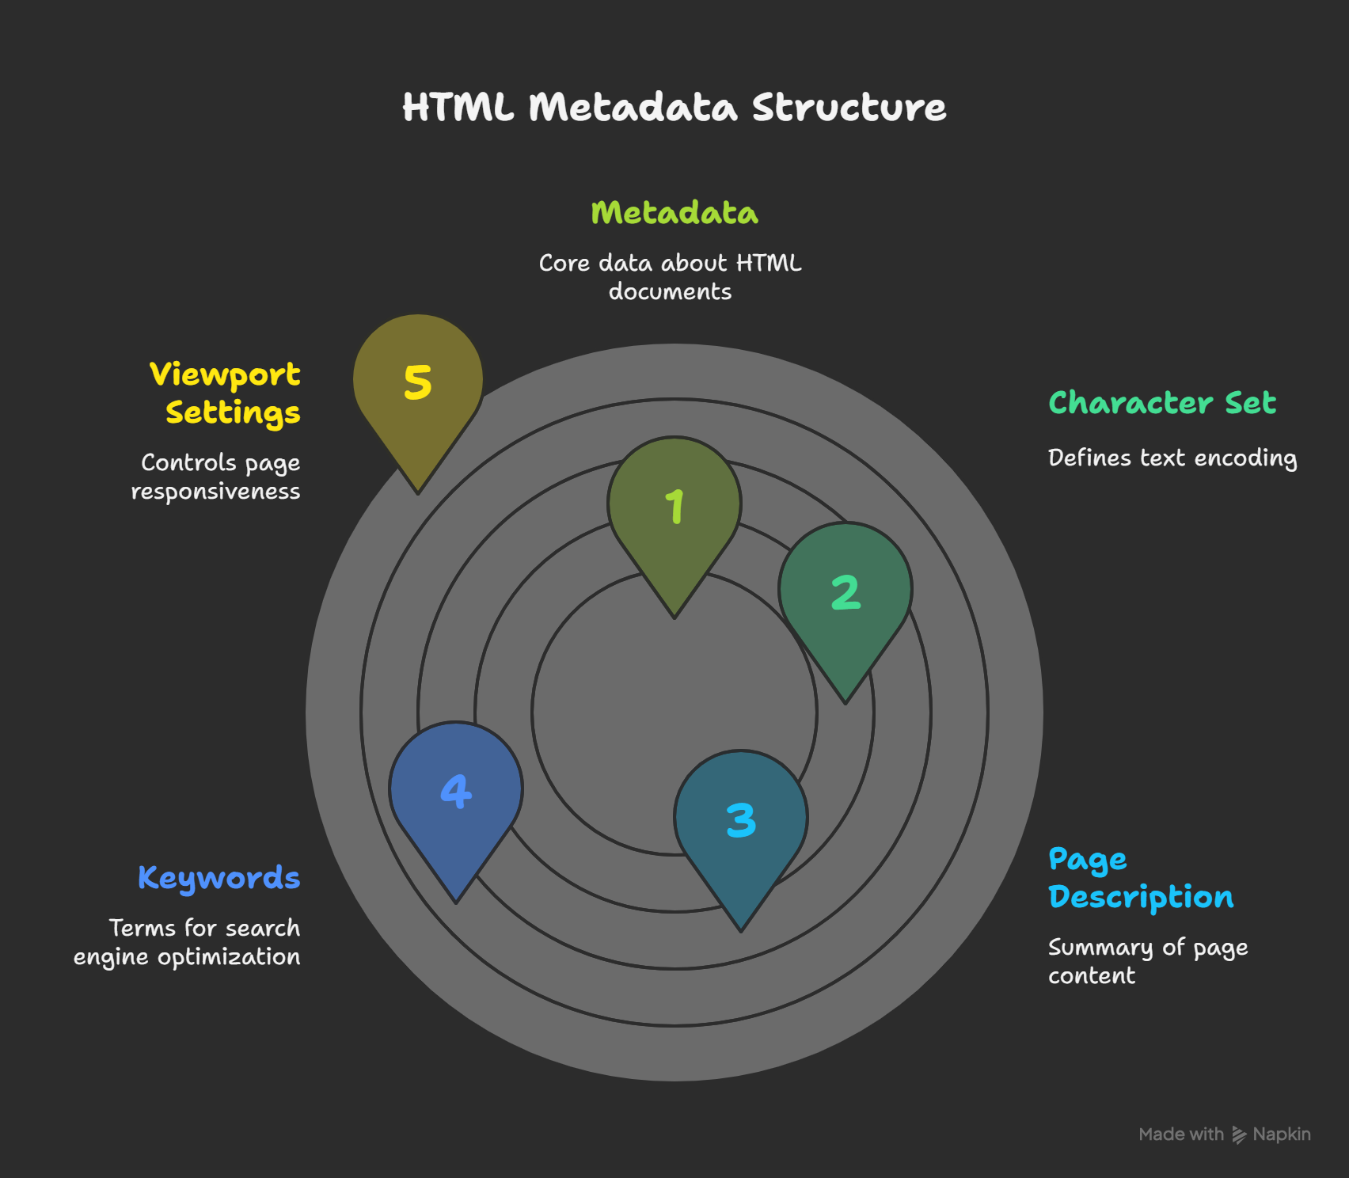
META DATA STRUCTURE:

Slide 5
EXAMPLES:
Define keywords for search engines:
<meta name="keywords" content="HTML, CSS, JavaScript">
Define a description of your web page:
<meta name="description" content="Free Web tutorials for HTML and CSS">
Define the author of a page:
<meta name="author" content="John Doe">
Refresh document every 30 seconds:
<meta http-equiv="refresh" content="30">
Setting the viewport to make your website look good on all devices:
<meta name="viewport" content="width=device-width, initial-scale=1.0">

Slide 6
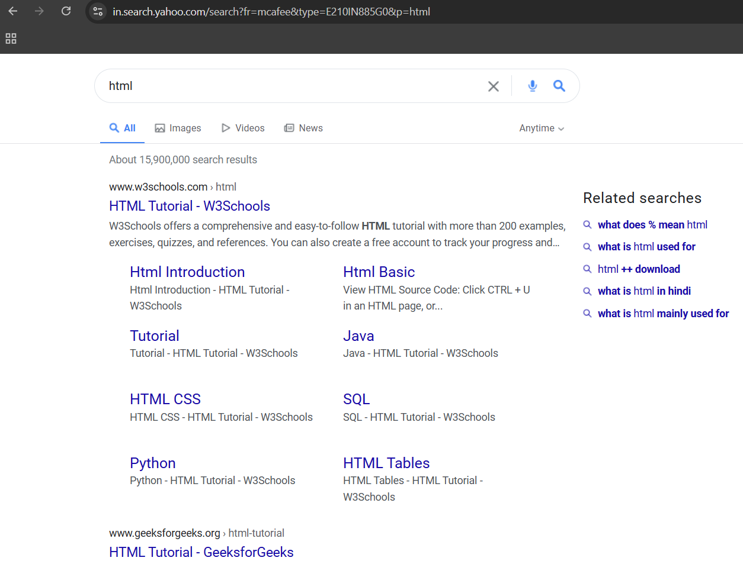
How Metadata Flows:
Browser → Reads metadata → Renders page correctly
Search Engine → Reads metadata → Ranks or describes page
Social Media → Reads Open Graph metadata → Shows preview cards
User Device → Reads viewport metadata → Adjusts page size and layout

Slide 7
Why Meta data Matters:
Benefit | Example
SEO (Search Engine Optimization) | Appearing higher on Google
Mobile Friendliness | Proper layout on phones/tablets
Faster Page Load | Right encoding, less confusion for browser
Good Social Media Previews | Attractive cards when sharing
Clear Ownership | Showing the author's name

Slide 8
OG(OPEN GRAPH):
Social media sites and web apps make use of Open Graph metadata tags to enhance the appearance of website links.
This allows better link previews with more information (such as description and image) so users can gather more info immediately.
What are Open Graph Meta Tags?:
The Open Graph is a protocol, an internet protocol, that was initially designed by Facebook (Meta) 2011 to incorporate metadata within a web page such as its image, title, meta description, and more, to better represent that page content when shared on the social media websites.
When you share your website on Facebook and LinkedIn, they use Open Graph tags to ensure the rich appearance of the URLs.

Slide 9
OG META TAG PROPERTIES:
There are mainly 2 og meta tag attributes namely:
Property
Content
There are mainly 5 types of properties:
Og.title
Og.image
Og.description
Og.url
Og.type

Slide 10
OG META TAGS ATTRIBUTES:
Tag | Purpose | Example
og:title | Title of the page | "Best Coffee Shops in NYC"
og:description | Short description of the page | "A curated list of top-rated coffee spots."
og:image | Link to an image (must be absolute URL) | "https://example.com/coffee.jpg"
og:url | Canonical URL of the page | "https://example.com/coffee-guide"
og:type | Type of content (e.g., website, article, video, etc.) | "website"
og:site_name | Name of your site | "CoffeeLovers"

Slide 11
EXAMPLE:
<head>
<!-- Basic OG Meta Tags -->
<meta property="og:title" content="The Ultimate Guide to Space Travel">
<meta property="og:description" content="Learn everything about rockets, planets, and the future of interstellar travel.">
<meta property="og:image" content="https://example.com/images/space-travel-guide.jpg">
<meta property="og:url" content="https://example.com/space-travel">
<meta property="og:type" content="article">
<meta property="og:site_name" content="Galactic Adventures">
</head>
Other 4 more properties are:
Og.author
Og.published time
Og.video-→Video type,video width,video height
Og.price amount

Slide 12

Why OG Meta Tags:
Without OG tags:
Someone shares your link.
Random text and a random image (maybe even your site's footer) appear.
Looks ugly ➔ People ignore it.
With OG tags:
Nice image + catchy title + short description.
Looks like a proper "card" ➔ People are curious and click.

